Slide 2

Jasleen Kaur Sondhi
Final year student pursing triple majors in Physics, Mathematics and Computer Science, Mount Carmel College, Bangalore.
R Programming Intern at SIRPI, Visualize and Decide.
Beta Microsoft Learn Student Ambassador.
R Programming Textbook Companion under publication process by IIT Bombay, FOSSEE Fellowship.
Certified by Duke University in Data Science Math Skills.
Skills- R, Python, Data Science, Tableau (among others)
Mentor at Yay-Lets Celebrate Education.
LinkedIn-https://www.linkedin.com/in/jasleen-sondhi/
Email- Jasleen.Sondhi@studentambassadors.com

Slide 3
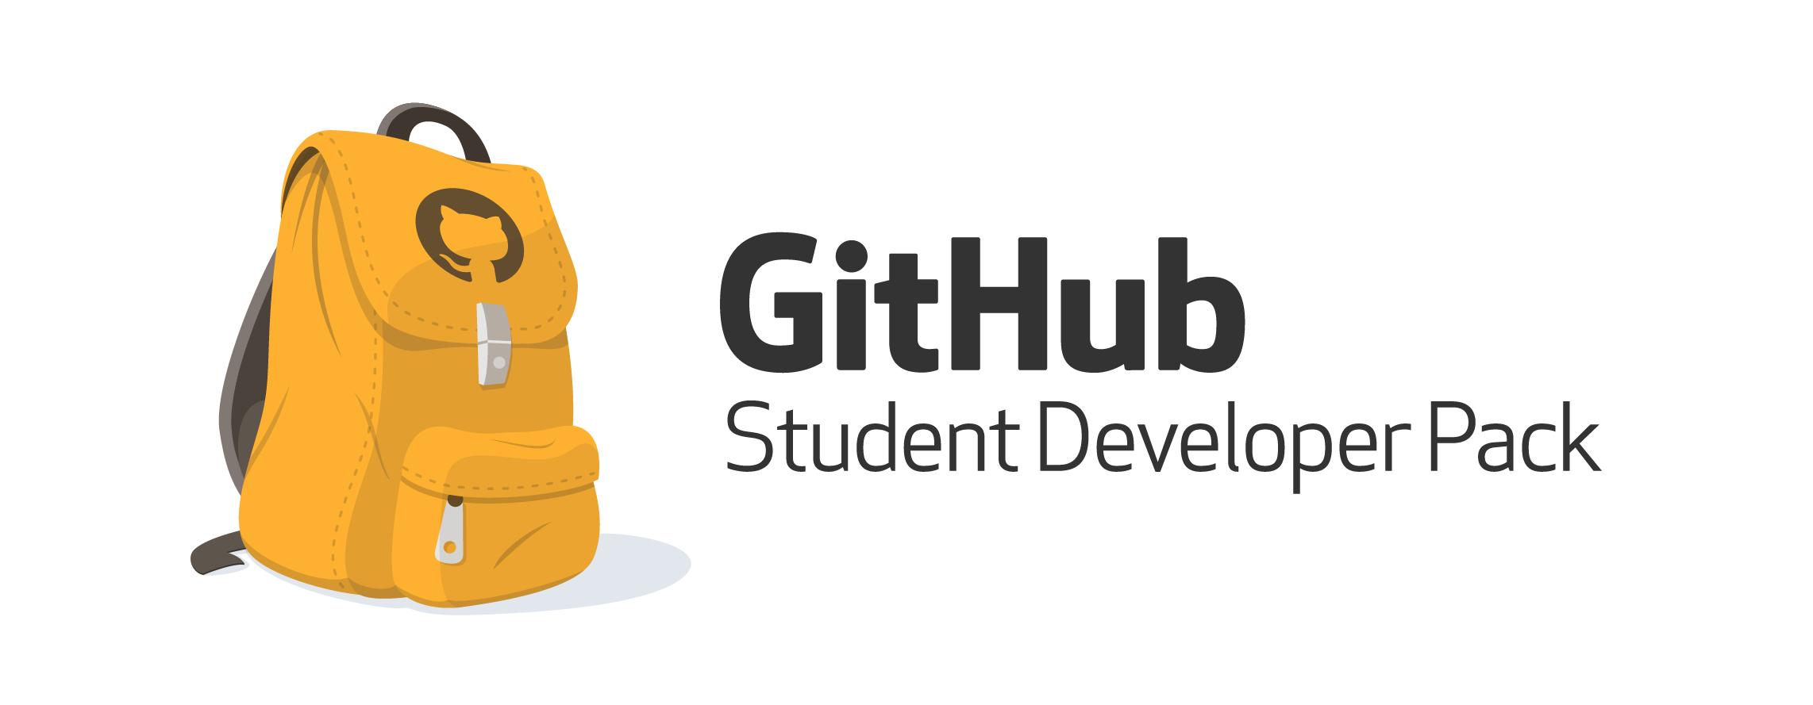

How to apply for the GitHub Developer Student Pack
Jasleen Sondhi

Slide 4
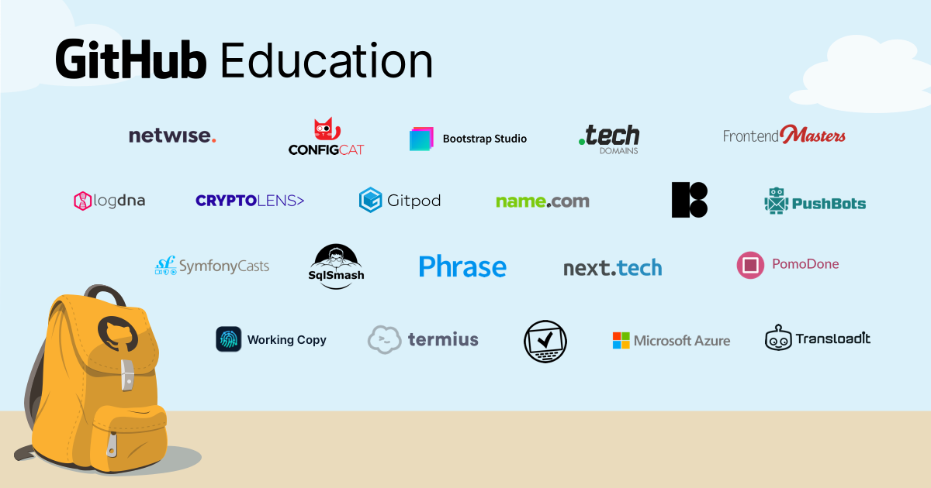
What is the Student Developer Pack?
Most of the professional-grade software comes at a cost that, all most all the students in this world can’t afford, this is where GitHub Education comes into the picture. GitHub Education is an platform which offers students real-world experience with free access to various developer tools.
There is a range of software and learning tools one can get for free with GitHub Education, a list has been linked here.

Slide 5
Requirements
To be eligible for the GitHub Student Developer Pack, you must:
Be currently enrolled in a degree or diploma granting course of study such as a high school, secondary school, college, university, homeschool, or similar educational institution
Have a verifiable school-issued email address or upload documents that prove your current student status
Have a GitHub user account
Be at least 13 years

Slide 6
Application Process
Go to GitHub Education and, in the top right, click Get benefits.
Under "Which best describes your academic status?", select Student.
Select or add the email address you use for school.
For example- MS18XXX@mccblr.edu.in
If prompted, upload proof of your academic status.
Enter your school's name.
Describe how you plan to use GitHub.
Verify your application details, then click Submit your information.

Slide 7

Once your application is accepted you will be able to access the Developer Tools!

Slide 8

GitHub Campus Expert Program

Slide 9
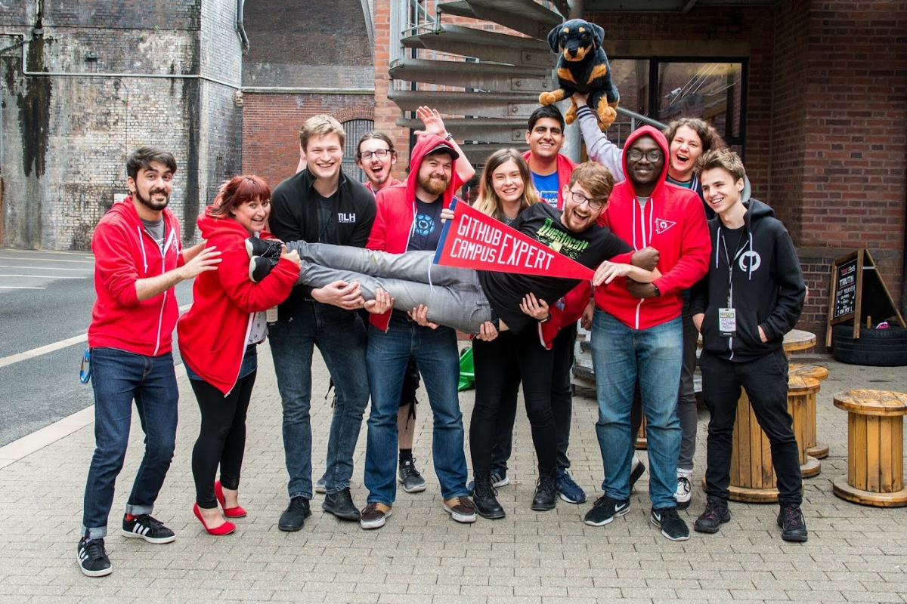
What is a Campus Expert?
People learn better when they can learn with a community of likeminded peers. A Campus Expert is a student trained to build a strong technical community, on campus. As well as training, Campus Experts have access to resources and support from GitHub, such as swag, sponsorship, and the opportunity to attend events like GitHub Universe.

Slide 10

How do I become a Campus Expert?
To become a Campus Expert, you first have to complete the training. To join the training, you need to be a verified student, over the age of 18. To verify as a student, sign up for the GitHub Student Developer Pack. Once you are verified as a student, you can join the Campus Expert training .

Slide 11

What are the benefits that I will get?
As a Campus Expert completes more training modules, they will gain access to more resources to use to help their community. Benefits range from free stickers and cheat sheets for your school, to event/hackathon sponsorships, to travel support to attend GitHub events and conferences.
In addition to material resources and benefits, Campus Experts gain access to regular webinars and guest talks from industry experts, and spaces to collaborate with other Campus Experts and GitHubbers.

Slide 12


Thank you!

